Slide 1
7 Momuments
Naqiyah

Slide 2
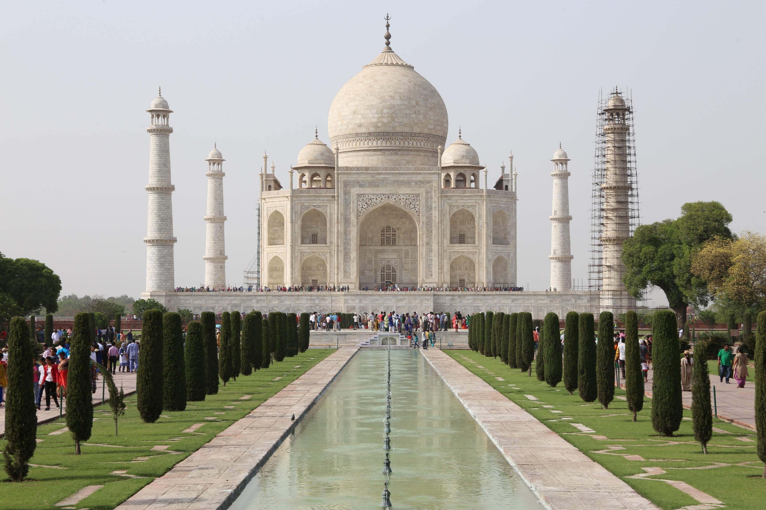
Taj Mahal
Taj Mahal is built in the loving memory of Mumtaz Mahal, wife of Emperor Shah Jahan.
Taj Mahal is one of the famous historical monuments in India.

Slide 3
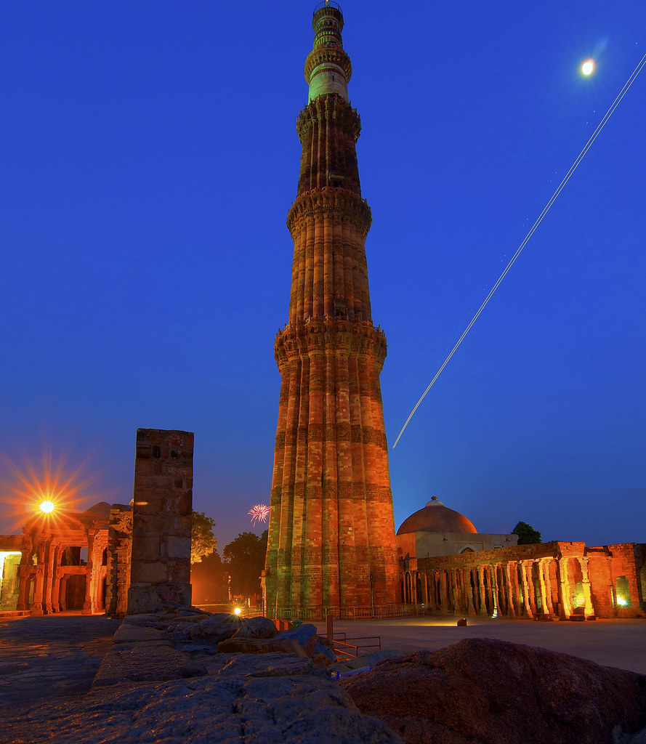
Qutub Minar Complex
Qutub Minar is a 72.5 metress beautiful minaret having 5 stories.
It is located in Mehruli,Delhi.
It was named after famous saint Qutub,ud,din Bakhtyar Kaki (R.A.).
This Photo by Unknown Author is licensed under CC BY-SA-NC

Slide 4
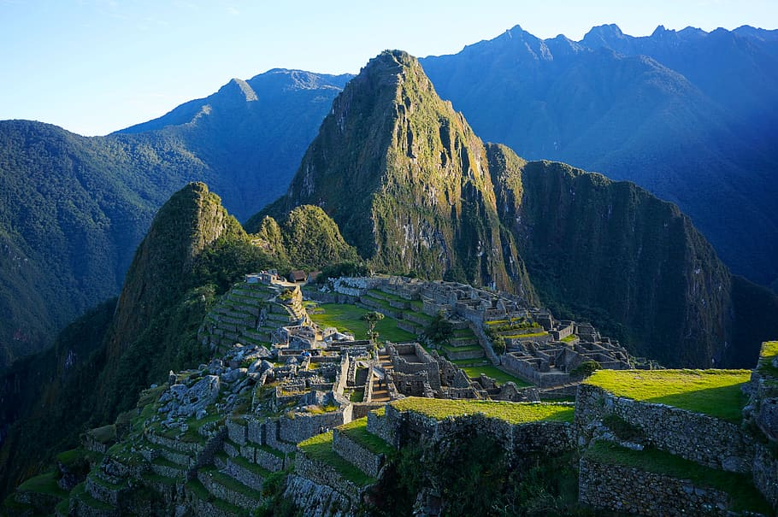
Machu Picchu
Today Machu Picchu is a great tourist attraction.
The first sight of Machu Picchu is almost magical.
A curious llama at Machu Pichu.

Slide 5
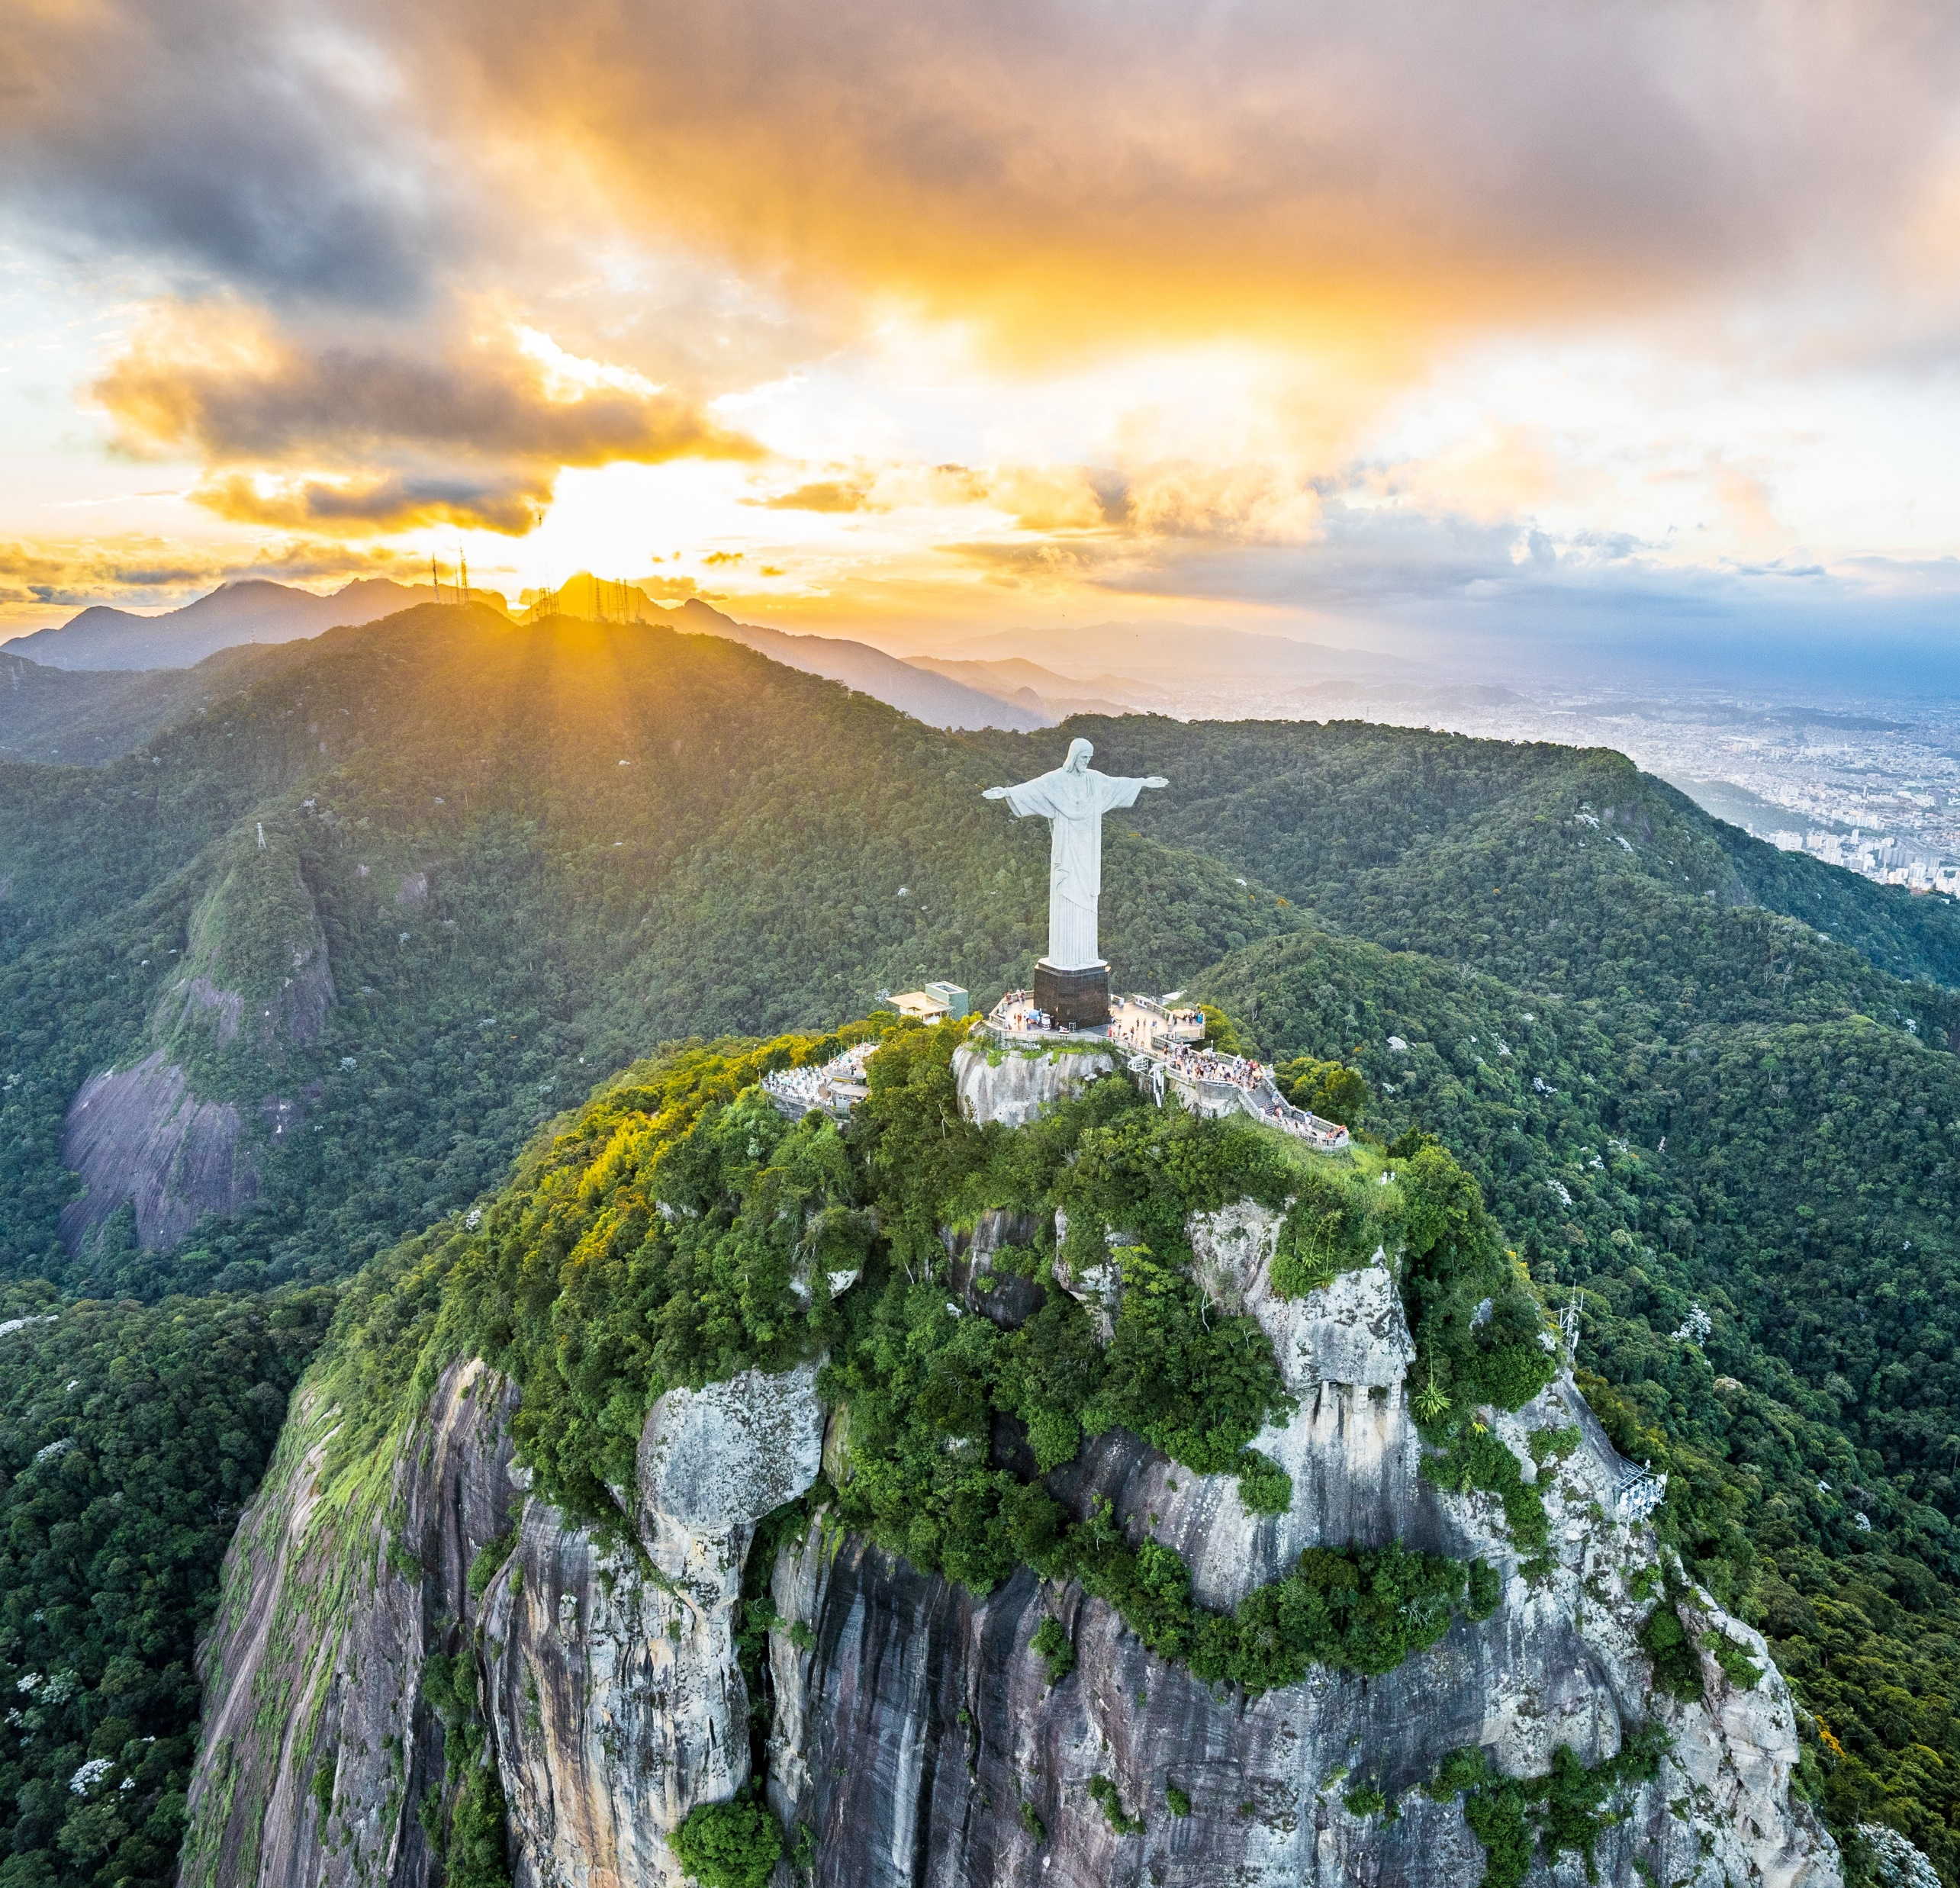
Christ the Redeemer
Chirst the Redeemer is the largest art deco statue in the world.
The statue weighs approximately 635 tonnes.

Slide 6
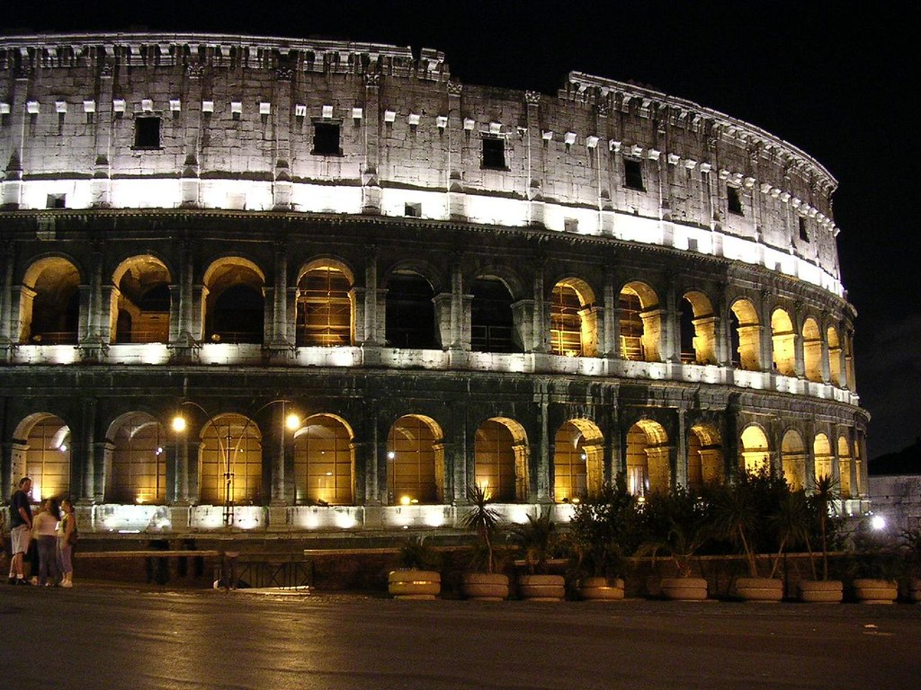
The Colosseum
The Colosseum,also know as the Flavian Amphittheatre,is a large artefact or structure in the city of Rom.
Emperor Vespasian started all the work,and Emperor Titus completed the Colosseum.
This Photo by Unknown Author is licensed under CC BY

Slide 7
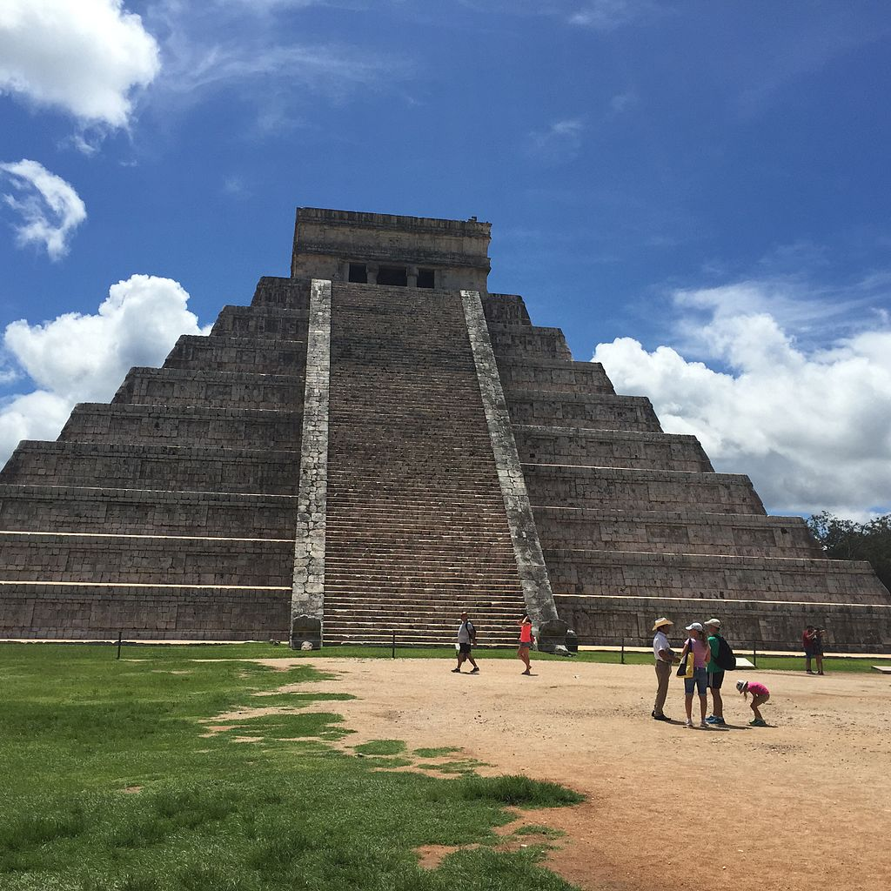
The Chichen Itza
This famous Mayan site may not be entirely Mayan.
Chichen Itza gets its name from a cenote nearby.
Monuments of chichen Itza were astronomically aligned.
This Photo by Unknown Author is licensed under CC BY-SA

Slide 8
THANK YOU

